Slide 1

Thumbs Up, Thumbs Down:
Using Natural Language Processing for Content Suggestion in the Streaming Industry

Slide 2
Introduction
How do we make suggestions/recommendations?
NLP translates natural language into machine-usable information for data analysis
Machine learning models can turn natural language from user bases into useful information about what they like and dislike
Thesis: ML and NLP can be used as a first step toward accurate content suggestion

Slide 3


NLP at a glance
Steps for determining sentiment:
Preprocess input data
Feature Selection
Feature Extraction
Model Training
Testing/Validation
Post-processing

Slide 4
Preprocessing
Tokenization
Lemmatization
Stop-word filtering

Slide 5
Feature Selection
Definition: determining which elements of the input data set are relevant contributors to their sentiment value
Methods:
Local
Global
Categorical

Slide 6
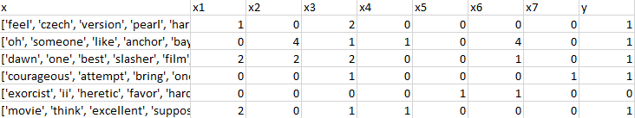
Feature Extraction
Definition: creating a feature score for each input sample
Methods:
Term Frequency (TF)
Term Frequency Inverse Document Frequency (TFIDF)

Slide 7
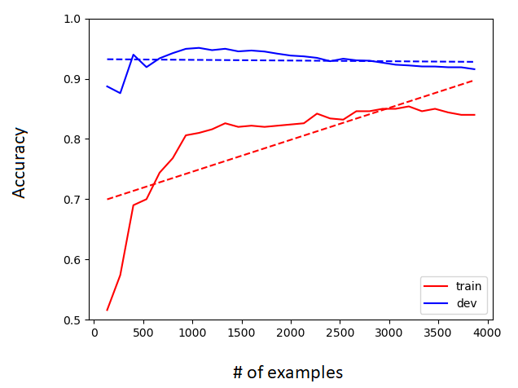
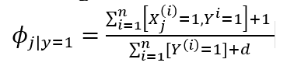
Model Training
Definition: process whereby the weights (importance) of each feature is updated either based on probabilities or other mathematical formulations
Models:
Naïve Bayes
Logistic Regression
Support Vector Classification

Slide 8
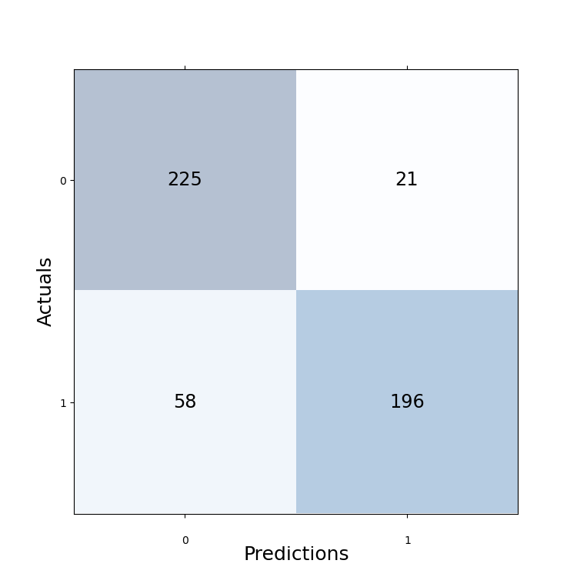
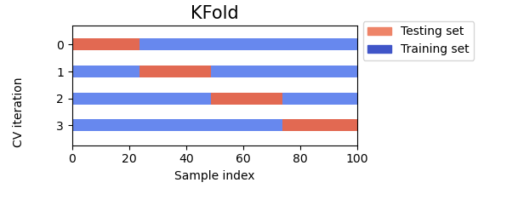
Testing and Validation
Initial data set is split up into 3 parts: training 80%, validation 10%, testing 10%
Testing
Accuracy vs other metrics
Bias-variance
Validation
K-fold

Slide 9
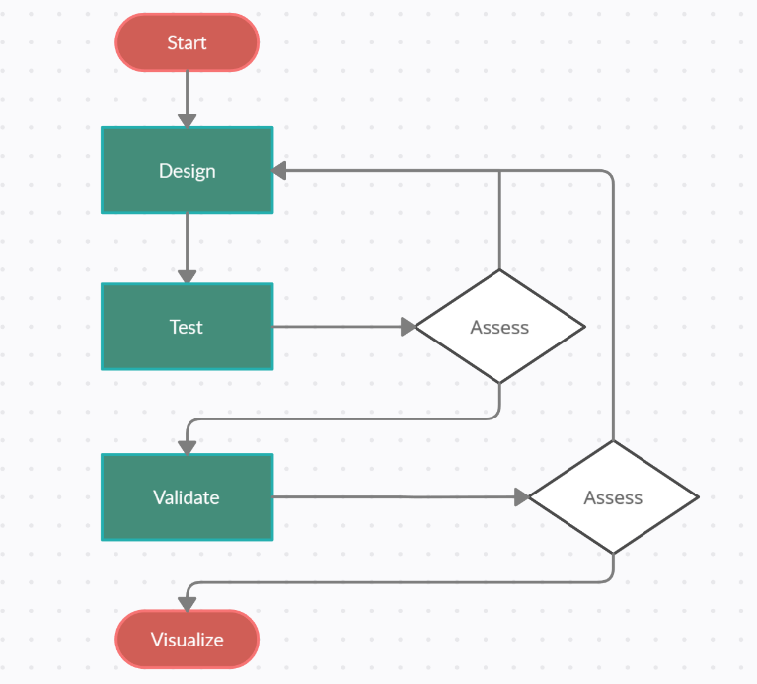
Postprocessing
Assessing results
Re-engineering

Slide 10
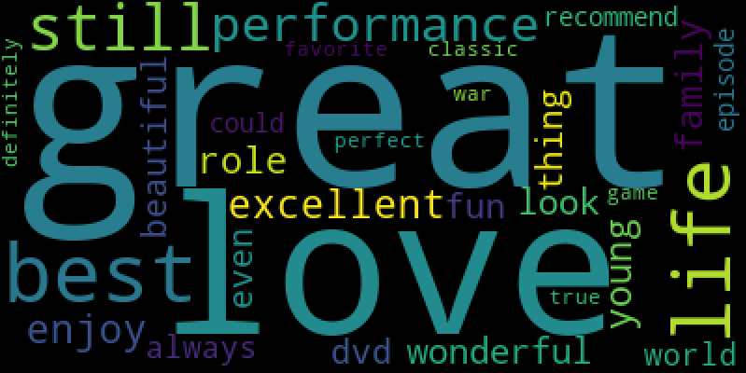
Content suggestion model
Learn what users like with NLP models
Evaluate other title options in terms of their preferences
Set score threshold, and recommend

